Slide 1




Real-Time Use Cases: Data Architecture in Action
Instant Driver Matching: Your Ride, On Demand
Smart Surge Pricing: Ensuring Rides Are Always Available
Precise ETA Predictions: Peace of Mind for Every Journey
Real-Time Fraud Detection: Protecting Every Transaction
Ever wonder how your ride appears almost instantly after you tap 'request'? Our powerful systems spring into action, rapidly scanning for the perfect driver nearby. We factor in everything from their live location to their past reliability, connecting you with an optimal match in just 1-2 seconds. This ultra-fast process doesn't just reduce your wait time; it boosts customer satisfaction and keeps our drivers efficiently on the move, leading to more completed trips and higher earnings for them.
In a world of constant digital transactions, trust and security are paramount. Our advanced pattern recognition algorithms tirelessly analyze every trip and payment event as it happens, flagging suspicious activities like GPS spoofing or payment fraud the instant they occur. This robust, automated system can block fraudulent transactions immediately, safeguarding both our customers' financial security and the company's integrity, potentially saving millions in losses annually.
During peak hours or bad weather, demand for rides can skyrocket. Our dynamic surge pricing isn't just about higher fares—it's about ensuring a ride is *always* available when you need it most. By constantly monitoring demand and driver availability across the city, we instantly adjust prices. This encourages more drivers to get on the road, guaranteeing service availability and optimizing revenue for the platform, all while being transparent with riders about the fare.
"When will my ride arrive?" is a common question. Our sophisticated machine learning models, trained on millions of past trips and fed with real-time traffic data, provide remarkably accurate estimated times of arrival. Your ETA is continuously updated as conditions change, giving you peace of mind and reducing anxiety. This commitment to accuracy significantly enhances rider experience, leading to higher ratings and repeat business.

Slide 2


RELIABILITY & SCALE
Uninterrupted Service: Building Systems That Never Fail You
Imagine a world where your essential services just... stop. At Uber, we understand that reliability isn't just a technical term – it's the bedrock of customer trust and business success. Our architecture is engineered to be as robust as a city's emergency services, designed to perform perfectly even when unexpected events occur, ensuring your journey is always smooth and secure.
Our Digital Safety Nets: Handling Any Hiccup
Seeing Everything: Our Eyes on the System
Just like a city has multiple power lines and backup generators to prevent blackouts, our system is built to withstand failures at every turn. We assume things *will* go wrong, so our systems are ready for anything, preventing disruptions before they even impact you.
Think of it like a control tower monitoring every flight, or a doctor checking vital signs. We constantly watch over our entire digital infrastructure, from individual servers to broad trends, to catch and fix issues often before they even become noticeable.
Kafka Replication: Always a Backup! Every piece of crucial information (like your ride request) is copied and stored in multiple locations. If one server goes down, another instantly takes over, so your data is never lost, and your ride request is always processed.
Kafka Lag Monitoring: We instantly know if information isn't flowing as fast as it should, preventing bottlenecks.
Flink Job Metrics: We track how efficiently our data processing is running, ensuring rapid responses.
Flink Checkpointing: Picking Up Where We Left Off. For complex tasks like tracking your driver's route, our system regularly saves its progress. If something unexpected happens, it simply restarts from the last save point, ensuring every calculation is correct and no detail is missed.
Database Performance Metrics: Constant checks ensure our data is always accessible and performing optimally.
Application-Level Metrics: We monitor key business indicators, like how many rides are completed, to ensure our services meet expectations.
Database Redundancy: Your Data, Protected. Our main databases always have active standbys. It's like having a duplicate brain for all our operations. If the primary system falters, the backup seamlessly steps in, guaranteeing continuous access to vital information.
Distributed Tracing: Like a GPS for every request, we can follow its journey through our complex system to pinpoint any slowdowns.
Circuit Breakers: Preventing a Domino Effect. If one part of our system gets overwhelmed, like a busy street during rush hour, our "circuit breakers" kick in. Instead of letting the problem spread and cause a system-wide crash, they isolate the issue, ensuring other services remain unaffected and responsive.
99.99%
<100ms
10M+
Rock-Solid Uptime
Lightning-Fast Responses
Massive Scale, Seamlessly Handled
Our commitment to near-perfect annual availability means rides are always there when you need them, protecting your peace of mind and our revenue.
Rapid response times for critical operations enhance user experience and maintain customer satisfaction.
Processing millions of events per second ensures our platform can handle peak demand without breaking a sweat, supporting global growth.

Slide 3

ADVANCED CAPABILITIES
Our Brains Behind the Wheel: Smart Decisions, Real-Time Impact
Imagine a sophisticated brain constantly analyzing, learning, and predicting, making Uber's operations smarter, faster, and more efficient. That's our powerful Machine Learning and Analytics system at work – transforming raw data into lightning-fast, intelligent actions that drive our business forward and enhance every user's experience.
Predictive Power: Real-Time Intelligence in Action
The Data Storytellers: Crafting Insights for Smarter Models
Like an experienced doctor diagnosing symptoms in real-time, our system uses thousands of predictive models. These models continuously analyze live events – from traffic changes to ride requests – to make instant, impactful decisions. They learn from vast historical data but act in the present moment, ensuring Uber is always a step ahead.
Think of it like a sports coach meticulously reviewing game footage. To make truly intelligent predictions, our ML models need the best "stories" about what's happening. Our feature engineering pipeline continuously gathers, refines, and stores critical pieces of information – we call these "features" – from all corners of our platform, in real-time:
This translates to tangible benefits like:
Driver Performance: Key stats like how often a driver accepts rides, their cancellation rate, and average rating.
Anticipating Demand: Predicting where and when riders will need a trip, so we can intelligently position drivers and minimize wait times.
Rider Habits: Understanding how often a rider takes trips, their typical journey length, and preferred times of day.
Optimizing Routes: Guiding drivers on the fastest, most efficient paths, accounting for live traffic, road conditions, and even historical patterns of congestion.
Location Intelligence: Real-time traffic flows, popular pickup and drop-off points, and event hot-zones.
Dynamic Pricing: Smartly adjusting prices in real-time to perfectly balance the availability of rides with rider demand, ensuring a reliable service.
Timely Context: Factors like the time of day, day of the week, holidays, and major events influencing behavior.
This process ensures our models always have the most accurate and up-to-date context, preventing confusion and allowing them to make consistently brilliant decisions, just like a coach uses detailed stats to win games.
Instant Fraud Detection: Spotting suspicious payment or trip activity in milliseconds, protecting both riders and drivers from fraudulent behavior.
Boosting Driver Success: Understanding what keeps drivers happy and productive, helping us tailor incentives and support to ensure a vibrant driver community.
Gathering the Raw Information
Making Instant Predictions
Every tap, swipe, and trip generates a continuous stream of data, flowing in instantly from our apps and services.
Our ML models leverage these fresh insights to make incredibly fast predictions – often in under 10 milliseconds – like a seasoned weather forecaster predicting a sudden storm.
1
2
3
4
Transforming Data into Insights
Triggering Smart Actions
This raw data is immediately processed, calculating crucial "features" (those meaningful stories) and updating our knowledge base in real-time.
These rapid predictions directly power actions across the platform: adjusting prices, sending driver alerts, or flagging potential fraud – all happening automatically and precisely.

Slide 4

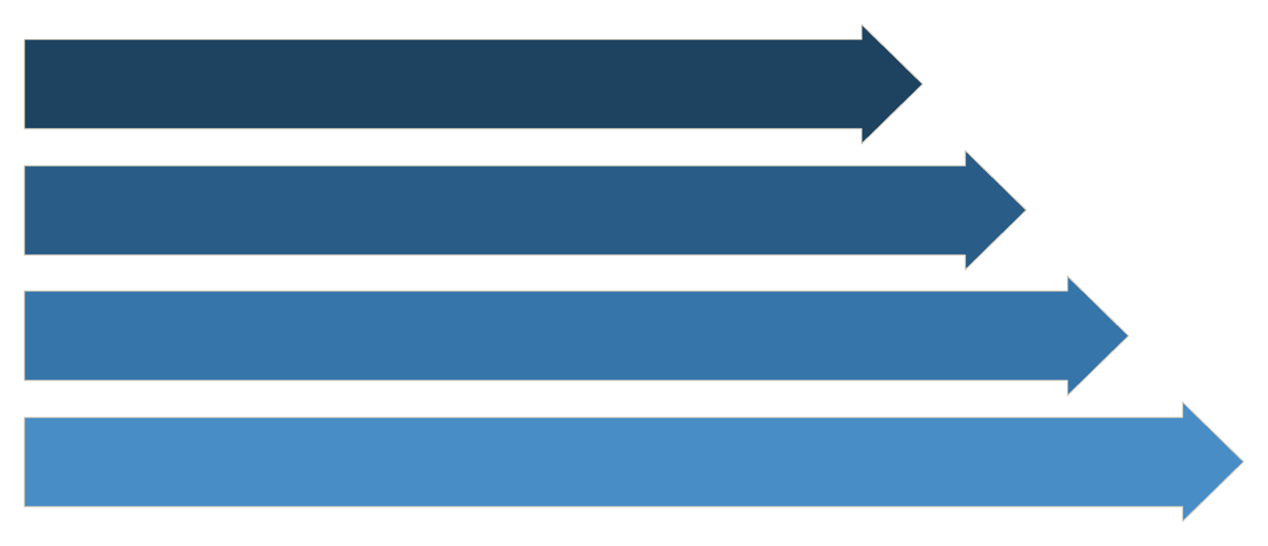










AI/ML CORE
AI/ML Architecture: Real-Time Intelligence at Scale
Uber's operations are powered by a sophisticated, real-time AI/ML architecture that processes vast amounts of data to make intelligent decisions in milliseconds. This system is designed for extreme scale, low latency, and continuous learning, ensuring a seamless and efficient experience for riders and drivers worldwide.
Data Ingestion
Feature Engineering
ML Model
Decision & Output
Michelangelo: Uber's Machine Learning Platform
Michelangelo is our end-to-end ML platform that empowers teams to build, deploy, and manage machine learning systems at scale. It provides a comprehensive suite of tools and infrastructure to accelerate the development of intelligent features across all Uber services.
Model Development
Training Infrastructure
Model Serving
Jupyter notebooks and feature engineering tools streamline the creation of new models.
Distributed training on Apache Spark and Horovod handles massive datasets efficiently.
Real-time inference APIs and batch prediction jobs ensure models are always available.
Monitoring & Management
Feature Store
Track model performance, conduct A/B tests, and manage deployments with ease.
Centralized management and serving of features for consistent and efficient ML.
Real-Time ML Pipeline Flow
Our ML pipeline operates continuously, transforming raw events into actionable intelligence with incredible speed.
Data Ingestion
GPS coordinates, trip requests, and user interactions stream via Kafka in <10ms.
Feature Engineering
Real-time & historical features (location, weather, user patterns) are extracted and computed.
Model Inference
Models predict demand, calculate ETAs, detect fraud, and match drivers instantly.
Decision Making
Predictions combine with business rules and A/B tests to generate real-time actions.
Feedback Loop
Actual outcomes (trip completion, satisfaction) feed back for continuous model improvement.
Key ML Use Cases & Technologies
Demand Forecasting
Dynamic Pricing (Surge)
Driver-Rider Matching
Tech: Time series (LSTM, Prophet), XGBoost
Tech: Reinforcement learning, gradient boosting
Tech: Optimization algorithms, deep learning
Output: Predicted demand by location & time
Output: Optimal pricing multiplier by hexagon
Output: Optimal driver assignment
Latency: <100ms
Latency: <200ms
Latency: <50ms
ETA Prediction
Fraud Detection
Tech: Deep Neural Networks, Graph Neural Networks
Tech: Anomaly detection, ensemble methods
Output: Accurate arrival time estimates
Output: Fraud probability scores
Latency: <100ms
Latency: <10ms
ML Infrastructure & Technologies
Training Infrastructure
Serving Infrastructure
Apache Spark: Distributed data processing
TensorFlow Serving: High-performance inference
Horovod: Distributed deep learning
ONNX Runtime: Cross-platform inference
TensorFlow/PyTorch: Deep learning frameworks
Redis: Feature caching for low-latency
Kubernetes: Container orchestration
Load balancers: Distribute requests
Feature Store
Experimentation Platform
Online store (Redis/Cassandra): Real-time serving
A/B testing framework: Compare model versions
Offline store (Hive/S3): Historical features
Statistical analysis: Measure model impact
Feature pipelines: Automated computation
Gradual rollouts: Safe model deployment
Feature monitoring: Quality & drift detection
Real-World Performance Metrics
1000+
100M+
<100ms
<10ms
Models in Production
Predictions per Second
Inference Latency
Feature Serving Latency
Continuously learning and optimizing operations.
Handling peak demand globally with ease.
95th percentile for lightning-fast decision making.
Instant access to up-to-date data for models.
ML Data Flow Example: Surge Pricing Decision
01
02
03
Trip Request Initiated
Feature Generation
Prediction Models Run
Rider opens app, GPS coordinates extracted, trip request sent.
Real-time features (current demand, driver availability) & historical features (past demand patterns, events) are retrieved.
Demand prediction model runs, identifying high demand in specific areas.
04
05
Pricing Decision
Decision Dissemination & Feedback
Pricing model calculates optimal surge multiplier (e.g., "1.5x surge") and business rules are applied to specific hexagons.
Decision sent to rider app ("Surge pricing in effect"), outcome tracked ("Trip completed"), and feedback feeds back to models for continuous learning.

Slide 5

NEXT-GEN AI
Agentic AI: The Autonomous Decision-Makers of Tomorrow
Imagine having thousands of intelligent assistants working 24/7, each capable of understanding complex problems, making smart decisions, and taking action without constant supervision. That's Agentic AI – Uber's revolutionary leap from simple automation to true artificial intelligence that thinks, adapts, and collaborates.
What Makes Agentic AI Different?
How Uber Uses Agentic AI Today
Traditional AI follows strict rules: "If this happens, do that." Agentic AI is fundamentally smarter:
Intelligent Customer Support: AI agents understand your issue, investigate automatically, suggest empathetic responses, and even translate complex policies into simple solutions – all in seconds.
Goal-Driven Autonomy: Like a skilled employee, it understands the objective and figures out the best way to achieve it, adapting as circumstances change.
Autonomous Workflow Orchestration: When a trip issue occurs (wrong route, toll charge), agents analyze what happened, determine fair resolutions, and communicate with both rider and driver without human oversight.
Multi-Agent Collaboration: Specialized AI agents work together like departments in a company – one handles customer queries, another optimizes routing, a third detects fraud – all coordinating seamlessly.
Real-Time Marketplace Optimization: Agents continuously balance supply and demand across thousands of city hexagons, adjusting pricing, driver incentives, and positioning recommendations autonomously.
Self-Healing Systems: When problems arise, agents can diagnose issues, adjust their approach, and recover automatically without human intervention.
Continuous Learning: Every interaction makes the system smarter, refining decisions and improving outcomes over time.
Predictive Problem Prevention: Agents spot patterns that humans might miss – like a specific intersection causing delays – and proactively reroute future trips.
Chain-of-Thought Processing
Like a human expert, Agentic AI breaks complex problems into steps, explaining its reasoning. This makes decisions transparent and trustworthy, not mysterious "black boxes."
Multi-Modal Intelligence
Agents process text, images, audio, video, and sensor data simultaneously. If you report wrong food delivered, the AI analyzes your photo, checks the order history, and determines the exact issue.
Real-Time Orchestration
Agents coordinate thousands of simultaneous workflows – from matching riders to processing refunds to detecting fraud – all happening in parallel at massive scale.
The Business Impact: Uber's Agentic AI has compressed workflows from days to hours, reduced operational costs by significant percentages, and improved quality standards beyond previous benchmarks – all while handling 36 million daily trips with minimal human oversight.
This isn't science fiction – it's the intelligent backbone powering Uber today and shaping how enterprises worldwide will operate tomorrow.

Slide 6


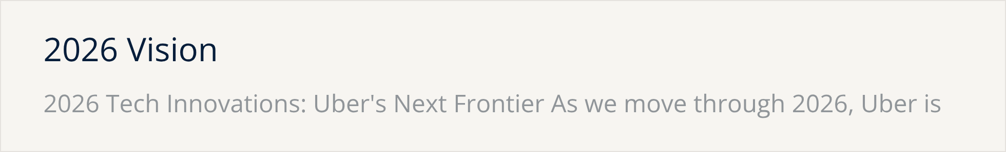

Slide 7
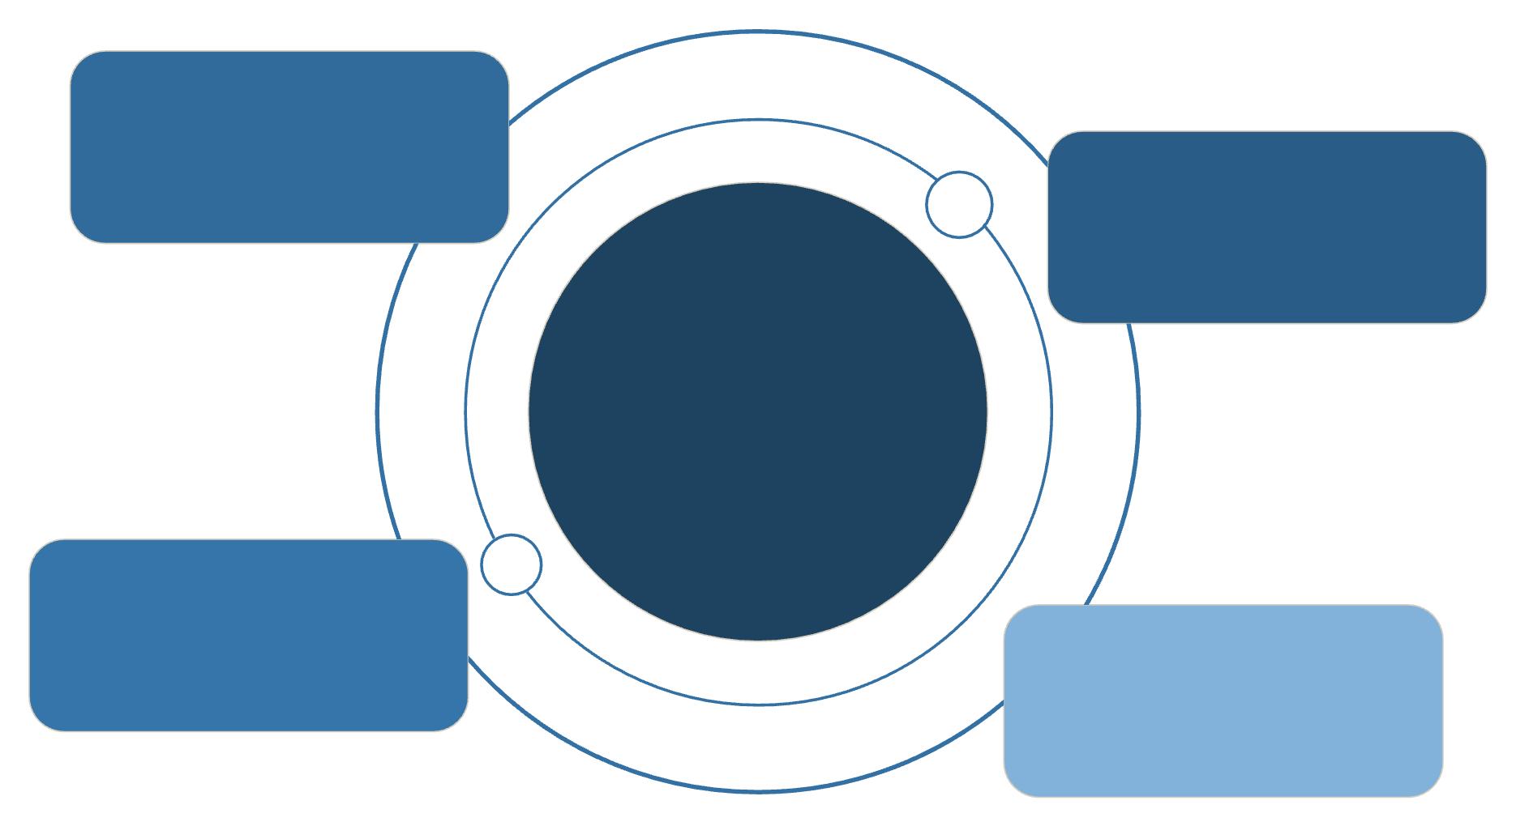
Uber's Complete Real-Time Data Ecosystem: The Full Picture
This comprehensive overview brings together the interconnected technologies and architectural layers that power Uber's intelligent mobility platform, enabling real-time decisions at unprecedented scale.
Data Sources
Smartphones, sensors, APIs
Ingestion Layer
API Gateway and Kafka streams
Uber Real-Time Ecosystem
End-to-end, high‑tech architecture
Stream Processing
Flink and real-time analytics
Geospatial Layer
H3 hex grid and mapping
Technology Stack Summary
Data Ingestion & Streaming
Stream Processing
Apache Kafka: 10M+ events/second
Apache Flink: <50ms processing latency
gRPC: High-performance communication
Apache Spark: Distributed computing
Protocol Buffers: Efficient serialization
Custom frameworks: Uber-specific optimizations
Geospatial Intelligence
AI/ML Platform
H3 Hexagonal Index: 15 resolution levels
Michelangelo: 1000+ models in production
Precision: <1ms coordinate-to-hexagon mapping
TensorFlow/PyTorch: Deep learning frameworks
Coverage: Global with local precision
Performance: 100M+ predictions per second
Latency: <100ms inference
Data Storage
Monitoring & Reliability
Redis: <1ms hot storage
Uptime: 99.99% operational availability
Cassandra: Millions of writes/second
Tracing: Distributed transaction visibility
PostgreSQL: ACID compliance for critical data
Resilience: Circuit breakers, auto-scaling
Hadoop/S3: Petabyte-scale archives
Data Flow: Complete Journey (Trip Request)
1
Request Initiation
Rider opens app; GPS coordinates sent via API Gateway, entering Kafka stream (<10ms).
2
Real-Time Processing
Flink processes location data, H3 converts coordinates to hexagon ID, features extracted for ML.
3
AI/ML Intelligence
Demand prediction, dynamic pricing, driver matching optimization, and fraud detection run concurrently.
4
Data Storage
Current state in Redis, trip events in Cassandra, transaction details in PostgreSQL, historical archived to Hadoop.
5
Decision Making
Business rules applied, A/B testing variations, and real-time orchestration determine optimal outcomes.
6
Response Delivery
Driver match to rider app, trip offer to driver app, operations dashboards updated, analytics systems notified.
7
Continuous Learning
Trip outcome feeds back to ML models; performance metrics collected for system optimization.
Scale & Performance Metrics
10K+
183M+
10M+
100M+
Global Reach
Monthly Users
Events/Second
ML Predictions/Sec
Cities served worldwide, fostering vast operational complexity.
Massive user base driving continuous data generation.
High-throughput real-time event processing capabilities.
Rapid, high-volume AI model inference for critical decisions.
<200ms
99.99%
End-to-End Latency
System Reliability
Achieving near-instantaneous trip matching and decision response.
Ensuring consistent availability for critical services globally.
Key Innovations & Business Impact
Core Innovations
Business Impact & Future-Readiness
Real-Time Stream Processing: Instant decision-making at scale.
Customer Experience: <2 second ride matching, seamless interactions.
H3 Geospatial Intelligence: Hexagonal world mapping for precise location services.
Operational Efficiency: Automated workflows reducing operational costs significantly.
Multi-Database Strategy: Right tool for every data need, optimizing performance.
Revenue Optimization: Dynamic pricing maximizing marketplace efficiency.
Michelangelo ML Platform: AI/ML at enterprise scale, powering intelligent services.
Global Scalability: Supports 36M+ daily trips and continuous expansion.
Agentic AI: Systems capable of autonomous decision-making.
Fault-Tolerant Architecture: 99.99% reliability with auto-recovery and resilience.
Autonomous Vehicles: Architecture ready for self-driving integration.
AI Evolution: Platform designed for next-generation AI capabilities and growth.

Slide 8

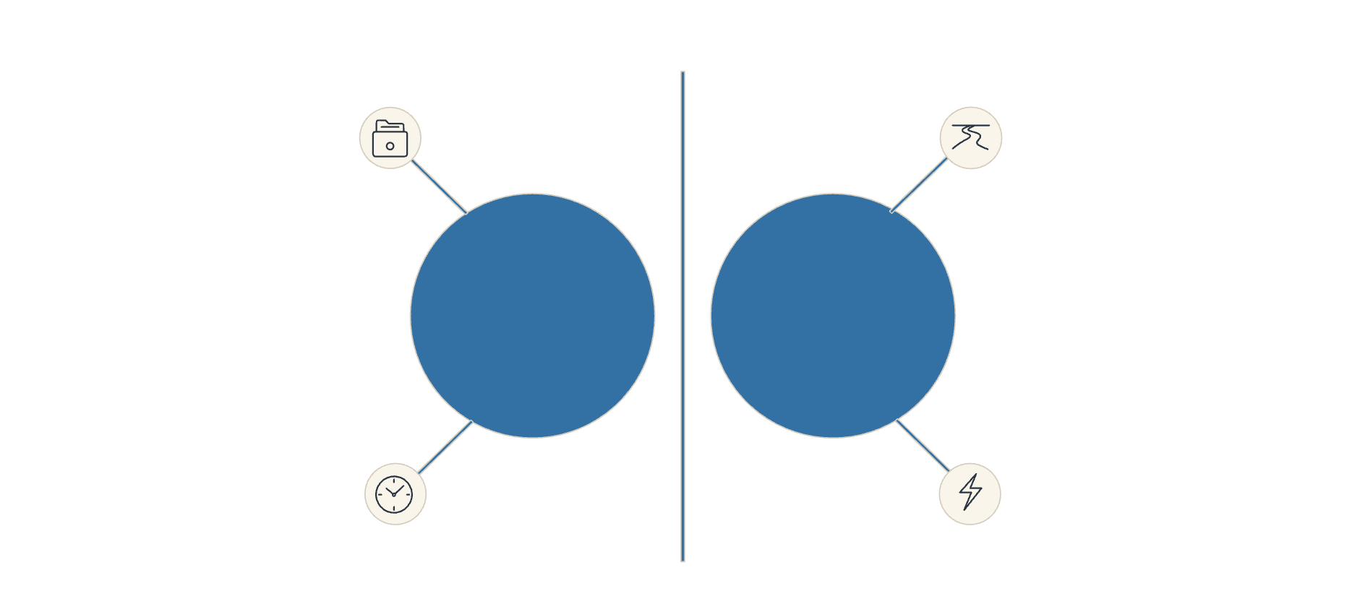








BANKING INNOVATION
Banking Reimagined: Unleashing Real-Time Intelligence for Superior Customer Experiences
Banks process billions of transactions daily, but often lack the real-time intelligence that modern platforms like Uber have mastered. This critical gap leads to reactive fraud detection, delayed customer insights, and a fragmented customer experience, costing the industry billions and hindering competitive advantage.
Uber's Real-Time Capabilities
What Banks Are Missing Today
Instant driver-rider matching (milliseconds)
Transactions still take hours/days to settle
Dynamic pricing based on live demand
Fraud detected after the fact, not prevented
Real-time fraud detection & prevention
Customer insights are batch-processed (daily/weekly)
Predictive surge management
No real-time personalization during transactions
Personalized recommendations in real-time
Risk assessment often happens post-transaction
Real-World Banking Scenarios Transformed by Real-Time Data
Fraud Prevention
Customer Experience
Uber: Detects suspicious driver behavior in milliseconds, blocks instantly.
Banking Gap: A fraudster makes 5 transactions before the bank detects it.
Solution: Real-time geospatial analysis (like H3) and stream processing to flag unusual patterns instantly, preventing fraud as it happens.
Uber: Knows your location, preferences, surge pricing – offers the perfect ride instantly.
Banking Gap: Customer calls bank, waits on hold, gets generic service.
Solution: Real-time customer context (location, transaction history, needs) enables instant, personalized offers and proactive support.
Settlement & Liquidity
Risk Management
Uber: Drivers get paid in real-time, money flows instantly within the platform.
Banking Gap: B2B payments take 2-3 days, Small & Medium Businesses wait for cash flow.
Solution: Real-time settlement using a stream processing architecture, accelerating cash flow and improving business efficiency.
Uber: Predicts surge demand 10 minutes ahead, deploys resources proactively.
Banking Gap: Risk teams analyze data after market closes, reacting to events.
Solution: Real-time risk prediction using Uber's stream processing and geospatial analysis, enabling proactive mitigation of financial risks.
From Reactive to Proactive: The Banking Transformation
Batch Processing
Stream Processing
Traditional Banking
Real-Time Banking
Delayed Insights
Instant Insights
Key Technologies Banks Should Adopt from Uber
Stream Processing
Geospatial Intelligence
Leverage technologies like Kafka/Flink for continuous, real-time transaction analysis and event detection.
Implement H3-like systems for location-based risk assessment, fraud detection, and personalized customer offers.
Real-Time Data Warehousing
Predictive Analytics
Build data architectures capable of providing instant customer insights and analytical capabilities.
Utilize machine learning for proactive fraud prevention, risk management, and personalized service delivery.
Banks that embrace Uber's real-time architecture will dominate the next decade of fintech, offering customers experiences that feel like magic: instant, personalized, and inherently secure.

Slide 9


The Reality Check: Wells Fargo's Current State vs. The Real-Time Future
Wells Fargo possesses strong foundational assets – an extensive customer base, robust financial infrastructure, and significant AI investments. However, like many incumbent banks, they are not yet operating at the real-time, agile level demonstrated by modern tech platforms like Uber. Here's an honest assessment of their current standing and the critical transformation needed.
Wells Fargo HAS TODAY (Current State)
Wells Fargo NEEDS TO BUILD (Future State)
AI investments: Primarily in chatbots, internal tools, and batch-based fraud detection.
Real-time stream processing architecture: Similar to Uber's Kafka/Flink for continuous data flow.
Customer data: Siloed across retail, commercial, and wealth management, limiting a unified view.
Unified customer data platform: Breaking down silos for a 360-degree customer view.
Infrastructure: Predominantly legacy systems, including mainframes from the 1980s-90s.
Modernized infrastructure: Cloud-native, microservices-based, and highly scalable.
APIs: Limited real-time capabilities; mainly for integration rather than streaming data.
Real-time APIs & event-driven architecture: Enabling instant interactions and data exchange.
Fraud detection: Reactive, identifying fraud after it has already occurred.
Predictive fraud prevention: AI that stops fraud proactively, before it impacts customers.
Customer insights: Batch-processed, relying on daily/weekly reports rather than real-time data.
Real-time customer intelligence: Millisecond insights for personalized, contextual experiences.
Settlement: Traditional, with B2B payments often taking 2-3 days to clear.
Instant settlement capability: Real-time payments for individuals and businesses.
Geospatial intelligence: H3-like systems for location-based banking services and risk assessment.
The Implementation Challenge
Technical debt: Replacing or integrating with decades-old legacy systems is complex and costly.
Organizational silos: Deep-rooted departmental separation hinders cross-functional data sharing and collaboration.
Regulatory complexity: Strict banking regulations can slow down rapid technological innovation and deployment.
Talent gap: A shortage of engineers skilled in real-time stream processing, cloud-native development, and advanced AI.
Timeline: A full transformation is a multi-year effort (3-5 years), not a quick fix.
The Opportunity Window
Competitors also behind: Major players like JPMorgan, Bank of America, and Citibank face similar challenges.
First mover advantage: The bank that successfully adopts real-time architecture first will dominate the next decade of fintech.
Customer expectations are rising: Consumers now expect Uber-like instant and seamless experiences across all services, including banking.
Technology is ready: Real-time architectures are proven and mature, successfully implemented by tech giants like Uber and Netflix.
Critical Success Factors
Executive commitment: CEO and leadership must champion this as a top strategic priority.
Massive investment: Billions will be needed for infrastructure modernization, talent, and R&D.
Aggressive talent acquisition: Hire top engineers and data scientists from leading tech companies.
Strategic partnerships: Collaborate with cloud providers (AWS, Google Cloud) and fintech innovators.
Agile transformation: Shift from traditional waterfall development to a flexible, iterative agile methodology.
Customer-centric mindset: Prioritize user experience and value delivery over internal processes and compliance alone.
The Bottom Line
Wells Fargo has the FOUNDATION but NOT the REAL-TIME ARCHITECTURE.
They have the ASSETS but NOT the AGILITY.
They have the CUSTOMERS but NOT the UBER-LIKE EXPERIENCE.
The question is: Will they move fast enough to capture this unprecedented opportunity?

Slide 10










BANKING INNOVATION
Wells Fargo's Competitive Advantage: Building the Real-Time Banking Platform
Wells Fargo is already investing heavily in AI and digital transformation. With 183 million customer relationships and $1.9 trillion in assets, they have the scale and resources to build the world's most advanced real-time banking platform. Here's how they can dominate the financial services landscape.
Wells Fargo's Foundational Strengths
Massive Customer Base
183M+ customers across retail, commercial, and wealth management provide unparalleled reach and data.
Existing AI Investments
Already deploying AI across multiple divisions, creating a strong base for real-time intelligence.
API-First Strategy
A modern approach enabling flexible and real-time data connections for seamless integration.
Global Infrastructure
Extensive data centers and processing power ready to handle massive real-time data streams.
Regulatory Expertise
Proven compliance and risk management frameworks crucial for financial services innovation.
Deep Customer Data
Rich transaction history and behavior patterns are a goldmine for personalized services.
Unlocking Competitive Advantage: Real-Time Opportunities
Real-Time Fraud Prevention at Scale
Hyper-Personalized Banking
Current: Fraud often detected after transactions occur.
WF Advantage: Detect fraud patterns across 183M customers in milliseconds using real-time stream processing.
Impact: Prevent billions in annual fraud losses and build unparalleled customer trust.
Current: Generic banking experience.
WF Advantage: Real-time customer context (location, transaction patterns, life events) delivers personalized offers at the exact moment of need.
Example: Customer near a car dealership receives an instant, pre-approved auto loan offer with the best rate.
Instant Settlement & Real-Time Liquidity
Predictive Financial Health
Current: B2B payments take 2-3 days.
WF Advantage: A real-time settlement platform for commercial customers, accelerating cash flow for millions of SMBs.
Impact: Become the preferred bank for businesses that demand instant liquidity, surpassing competitors like JPMorgan Chase.
Current: Banks react to customer problems like overdrafts or missed payments.
WF Advantage: Real-time analysis of spending patterns predicts financial stress, enabling proactive interventions.
Impact: Stronger customer relationships, reduced defaults, and enhanced financial well-being for customers.
Commercial Banking Intelligence
Current: Commercial customers wait for monthly/quarterly reports.
WF Advantage: Real-time dashboards showing cash flow, receivables, payables, and predictive forecasts.
Impact: Position Wells Fargo as the essential operating system for business banking, outperforming Bank of America.
Strategic Implementation Roadmap
Phase 1 (2025-2026)
Build real-time fraud detection and prevention system.
Phase 2 (2026-2027)
Launch hyper-personalized customer experience platform.
Phase 3 (2027-2028)
Deploy real-time settlement and liquidity platform.
Phase 4 (2028+)
Become the AI-powered operating system for banking.
Projected Market Impact
25-30%
40-50%
1.5x
Increase Customer Retention
Reduce Fraud Losses
Attract SMBs & Commercials
Through superior, magical customer experiences.
Protecting both the bank and its customers more effectively.
Become the top choice for real-time banking needs.
20%
Command Premium Pricing
Reflecting the unmatched value of superior service.
Wells Fargo has the scale, resources, and customer base to build the 'Uber of banking.' The bank that masters real-time intelligence will dominate the next decade of financial services. Wells Fargo is uniquely positioned to be that bank, leaving competitors like JPMorgan Chase and Citibank behind.

